Slide 1
Analytical Queries on Road Networks: An Experimental Evaluation of Two System Architectures
Shangfu Peng Hanan Samet
shangfu@cs.umd.edu hjs@cs.umd.edu
Department of Computer Science
University of Maryland
College Park, MD 20742, USA
SIGSPATIAL 2015

Slide 2
Outline
Background & Motivation
Spatial analytical queries
Access patterns & existing methods
Two architectures
Hybrid architecture
Integrated architecture (inside a database)
$ε$-distance oracle
SQL examples
Evaluation
Throughput
Region query, KNN query and Density
Conclusions

Slide 3
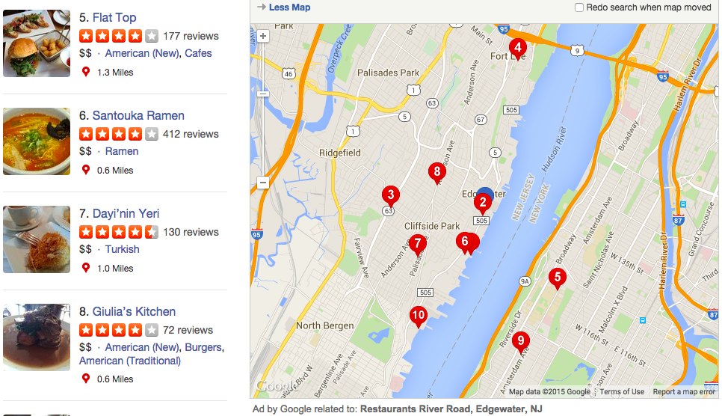
Motivation
Analytical queries on data embedded in a road network
Requires computing distances using along the road network
Much more than simple routing queries
Ex: Answering queries such as finding all restaurants within a two mile biking distance of River Road in Edgewater, NJ
Yelp results for the query: find the restaurants within a 2 mile biking distance.
Notes:
Here use euclidean distance

Slide 4
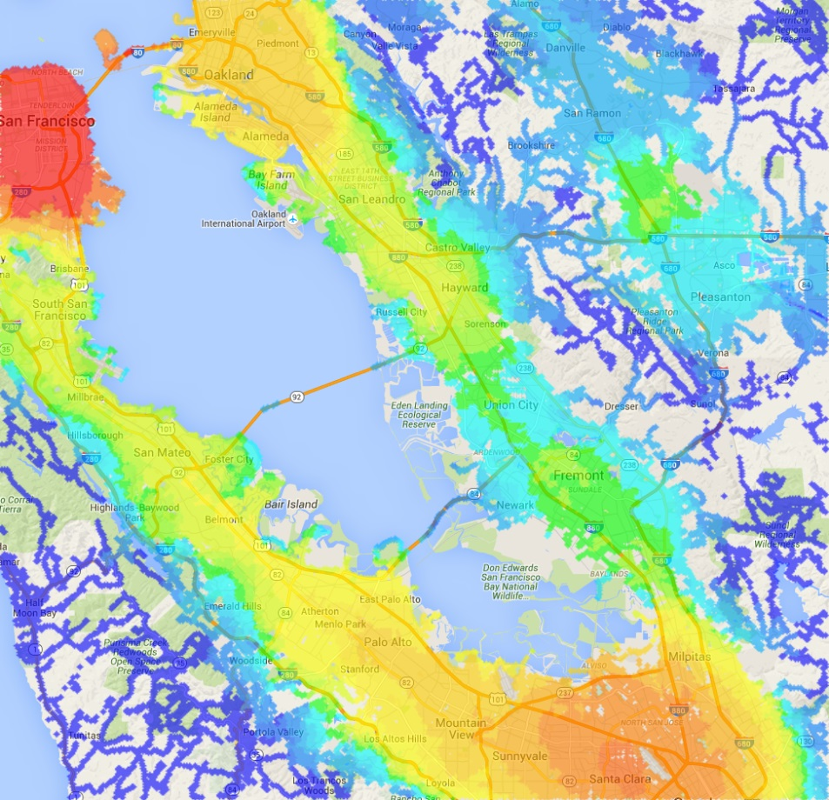
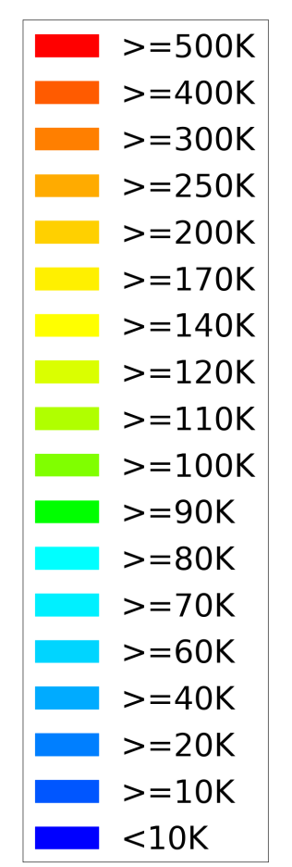
Example: Accessibility to Jobs
Popular among transportation planners
LODES dataset from census
Number of jobs within 10KM by car
Require millions distance computations to generate such heat map

Slide 5
Motivation
Analytical queries on data embedded in a road network
Requires computing distance using along the road network
Ex: Answering queries such as finding all restaurants within a two mile biking distance of River Road in Edgewater, NJ
Challenge lies in realization that each such query involves making hundreds to even millions of distance computations along a road network instead of “as the crow flies” (i.e., Euclidean distance)
Most methods aim at decreasing the latency time for one source-target query
Don't take into account factors such as multi-users, multi-threads, query optimization, etc
Our aim is to increase the throughput which means the total amount of time for the entire query
Throughput: number of distance computations per second
Notes:
logistics, tour planning,
and spatial business intelligence
Our aim is to increase the throughput which means the total amount of time for the entire query

Slide 6
Example of Queries from Esri Message Board
I am a taxi operator running a fleet of taxis. I have a dataset of taxi trips such that each trip has a latitude and longitude values for both a pickup and a drop off point, as well as for way points at irregular intervals. I want to obtain the total number of miles travelled by each taxi this month.
I am an operator of a large hospital and have the geocoded address of my patients and the locations of my clinics. Our hospital has more than 500 clinics across the country. I want to get the average drive time for patients per clinic. This is an important metric in healthcare. This distance also informs us of the need to open new clinics or relocate existing ones to better serve our patients.
I have a trucking company with 10 trucks that deliver thousands of packages for a popular retailer. A common operation that I run several times during each day is determining which packages should be loaded on to which truck and the order in which they should be delivered. For this purpose, the input is a network distance matrix between the delivery locations of all current packages. An optimization program would decide how to assign packages to trucks and the order in which to deliver them.

Slide 7
Access Patterns & Algorithms for Distance Queries
Analytical queries perform the following access patterns on the road network
One-to-One: a batch of source-target pairs
One-to-Many: KNN
Many-to-Many: distance matrix
Algorithms
Decompose
Algorithm Type | Access Pattern
 | One-to-One | One-to-Many
Scan-based (in memory) | Contraction Hierarchies TNR etc | Dijkstra’s algorithm etc
Lookup-based (in database) | $ε$-Distance Oracle Hub labeling | -
Notes:
Contraction hierarchies

Slide 8
Access Patterns & Algorithms for Distance Queries
Analytical queries perform the following access patterns on the road network
One-to-One: a batch of source-target pairs
One-to-Many: KNN
Many-to-Many: distance matrix
Algorithms
Decompose
Algorithm Type | Access Pattern
 | One-to-One | One-to-Many
Scan-based (in memory) | Contraction Hierarchies TNR etc | Dijkstra’s algorithm etc
Lookup-based (in database) | $ε$-Distance Oracle Hub labeling | -

Slide 9
Outline
Background & Motivation
Spatial analytical queries
Access patterns & existing methods
Two architectures
Hybrid architecture
Integrated architecture (inside a database)
$ε$-distance oracle
SQL examples
Evaluation
Throughput
Region query, KNN query and Density
Conclusions

Slide 10
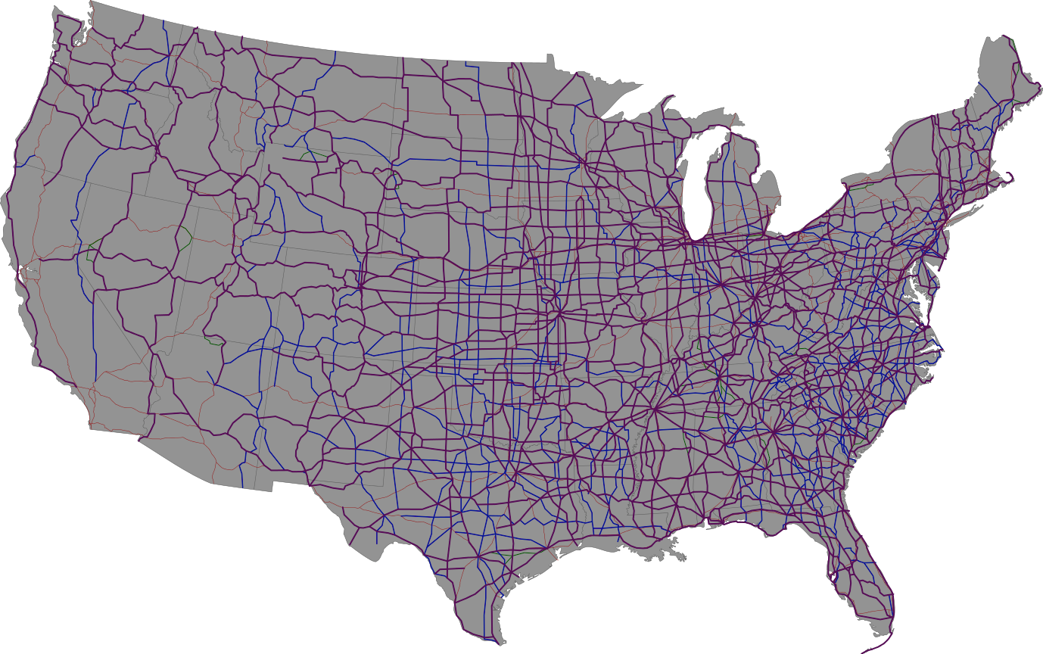
Hybrid Architecture
Decoupling the database from the distance computations
Retrieving location datasets from a database
Running distance computations in scanner module
Scanner module
In memory
Contains spatial indices
Optimizer module
Improve the scan plan
E.g, distance matrix
$N×M$, $N≫M$
Users dispense
with this step
APPLICATIONS
ANALYSIS TOOL
Optimizer
SCANS
SQL
ROAD NETWORK SCANNER
SCANS
One-to-Many
DATABASE
One-to-One
Datasets

Slide 11
Outline
Background & Motivation
Spatial analytical queries
Access patterns & existing methods
Two architectures
Hybrid architecture
Integrated architecture (inside a database)
$ε$-distance oracle
SQL examples
Evaluation
Throughput
Region query, KNN query and Density
Conclusions

Slide 12
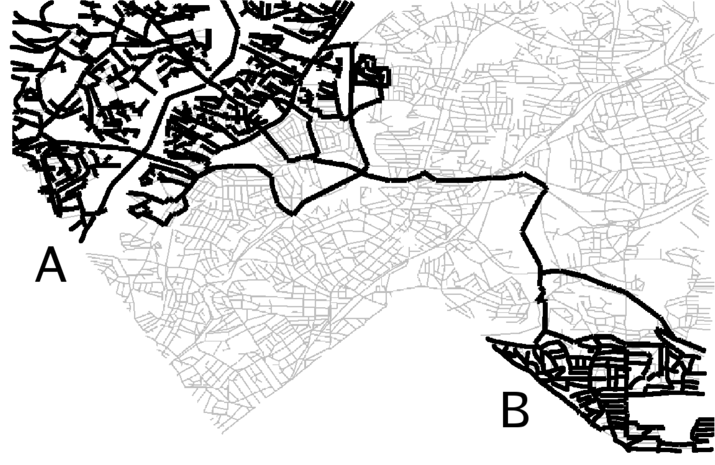
$ε$-Distance Oracle ($ε$-DO)
Assumes existence of well-separated pair decomposition (WSPD) on the road network
Can represent the distance between any two points in A and B by one value with an epsilon error tolerance
$O\left(\frac{n}{ε^{2}}\right)$ well-separated pairs, each well-separate pair can be represented as a key-value pair
USA road network with 24 million vertices
$ε=0.25$, 4.6 billion key-value pairs, 55 GB
$$∀s∈A, t∈B, \left(1−ε\right)d_{ε}\left(A,B\right)≤d_{G}\left(s,t\right)≤\left(1+ε\right)d_{ε}\left(A,B\right)$$

Slide 13
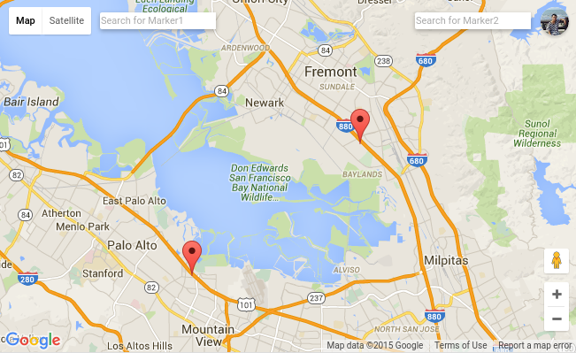
Example of $ε$-Distance Oracle ($ε$-DO)
Is $ε$-approximate result good enough?
In average, the error is less than $ε/10$
Road networks from OpenStreetMap
Method | Result
$ε$-DO, $ε=0.25$ | 27.802 KM
Exact Distance | 28.546 KM
Google Maps | 29.3 KM
Euclidean | 14.649 KM
$$http://sametnginx.umiacs.umd.edu/oracle$$
Notes:
Need to say small errors make very little difference

Slide 14
Integrated Architecture
APPLICATIONS
Embed $ε$-DO into a database
Dist(lat1, lon1, lat2, lon2)
A B-tree lookup
Leverage
GiST and Indices
Query Optimization
SQL language
SQL
Query Language Parsing
Logical Layer
DIST()
UDFs
Query Optimization
Relational Operators
Physical Layer
GIST
INDICES
Lookups
One-to-Many
One-to-One
DISTANCE ORACLE
DATASETS
-- Road distance between White House and US Capitol
SELECT DIST(38.8977, -77.0366, 38.8898, -77.0091)
-- This produces 2144.7 (meters)

Slide 15
Example Query Using Integrated Architecture
Find up to 100 houses with the maximum number of parks that lie within 0.5 km of road distance from the houses sorted by the number of such parks.
Tables: houses(id, lat, lon) and parks(id, lat, lon)
SELECT id, count(*) as count
FROM ( SELECT houses.id as id,
DIST(houses.lat, houses.lon,
parks.lat, parks.lon) as dist
FROM houses, parks
) as foo
WHERE dist < 500 -- 0.5km in meters
GROUP BY id
ORDER BY count DESC
LIMIT 100;

Slide 16
KNN Example Using Integrated Architecture
K nearest neighbors (One-to-One version)
POI(id, lat, lon) and a source location
Need to avoid computing all pairs of the source and POI
Algorithm:
Obtain the K nearest Euclidean distance neighbors using GiST
Compute their network distances and select the maximum one, denoted as $d_{m}$
Obtain all nearest objects whose Euclidean distance is less than or equal to $d_{m}$ , and then compute their network distances
Retain the K closest ones
Correctness: Euclidean distance is a lower bound on the network distance
Network distance of any point outside the red circle > $d_{m}$
$$d_{m}$$
source
$$d_{m}$$
K=3

Slide 17
KNN Example Using Integrated Architecture
K nearest neighbors (One-to-One version)
POI(id, lat, lon) and a source location
Need to avoid computing all pairs of the source and POI
Algorithm:
Obtain the K nearest Euclidean distance neighbors using GiST
Compute their network distances and select the maximum one, denoted as $d_{m}$
Obtain all nearest objects whose Euclidean distance is less than or equal to $d_{m}$ , and then compute their network distances
Retain the K closest ones
Correctness: Euclidean distance is a lower bound on the network distance
Network distance of any point outside the red circle > $d_{m}$
$$d_{m}$$
source
$$d_{m}$$
K=3

Slide 18
Outline
Background & Motivation
Spatial analytical queries
Access patterns & existing methods
Two architectures
Hybrid architecture
Integrated architecture (inside a database)
$ε$-distance oracle
SQL examples
Evaluation
Throughput
Region query, KNN query and Density
Conclusions

Slide 19
Evaluation
Setting
Integrated architecture using $ε$-DO in PostgreSQL
Hybrid architecture using Dijkstra’s algorithm
Single thread version
Multi-thread version (7 scanning threads in a 8-core machine)
Dataset
USA road network containing 23,947,347 vertices and 58,333,344 edges
49,573 locations of fast food restaurants in USA
5,964 locations of universities and schools in USA
11,220,058 GPS entries for 537 taxis in a one month in San Francisco

Slide 20
Throughput Evaluation
How many distance computations per second?
One-to-one access pattern
Integrated is far superior to Hybrid
One-to-many access pattern
Hybrid (Dijkstra’s algorithm) amortizes the costs of scans from a single source to multiple destinations
Therefore, the Hybrid throughput for a distance matrix is much better than the one for random pairs
Query | Metric | Integrated | Hybrid - 7
10K random pairs | Time | 0.327 sec | 2026 sec
 | Throughput | 30581 dist/sec | 4.9 dist/sec
Distance Matrix (5,964$×$49,573) | Time | 8853.9 sec | 20139 sec
 | Throughput | 33392 dist/sec | 14680 dist/sec

Slide 21
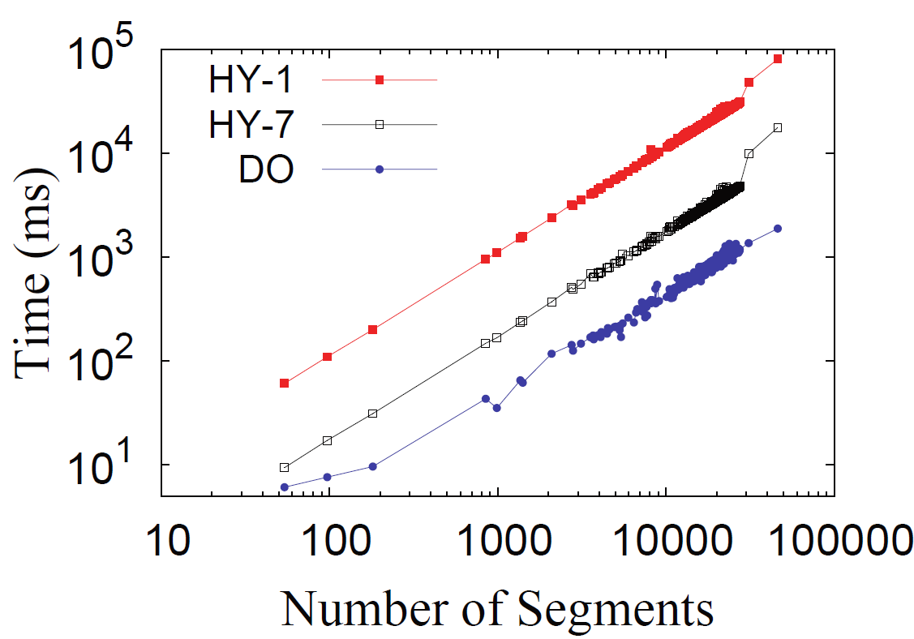
Evaluation of the Effect of Distance
Distance between points influences the time cost in the one-to-one access pattern
Execution time increases with distance between points for most scan-based methods (Hybrid)
Execution time is not related to distance for most lookup-based methods (Integrated)
Travel distance of each taxi
The endpoints of each segment are near to each other
See http://roadsindb.com/
Notes:
The execution time of computing the total travel distance of each taxi

Slide 22
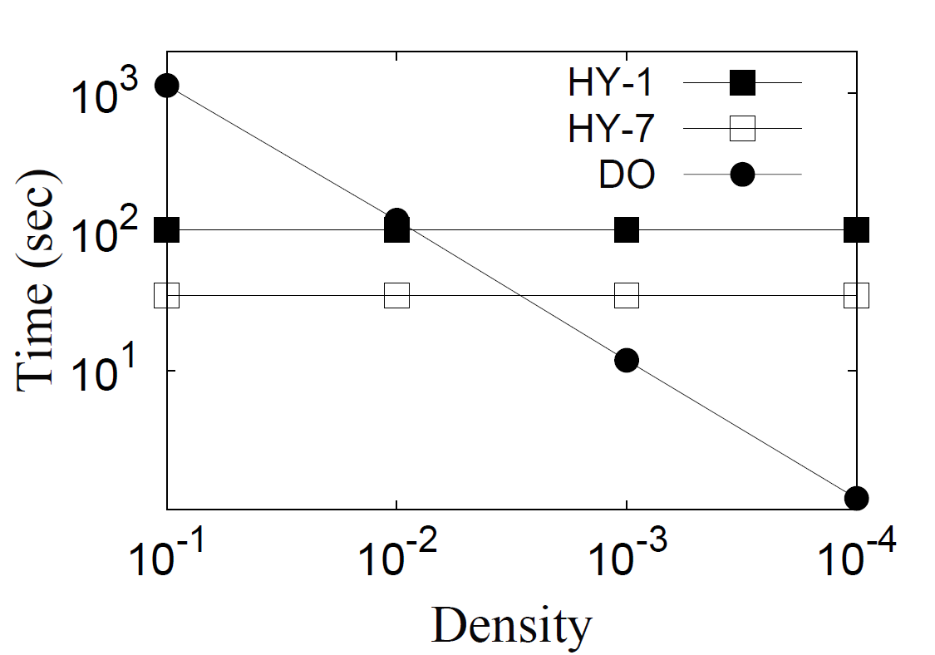
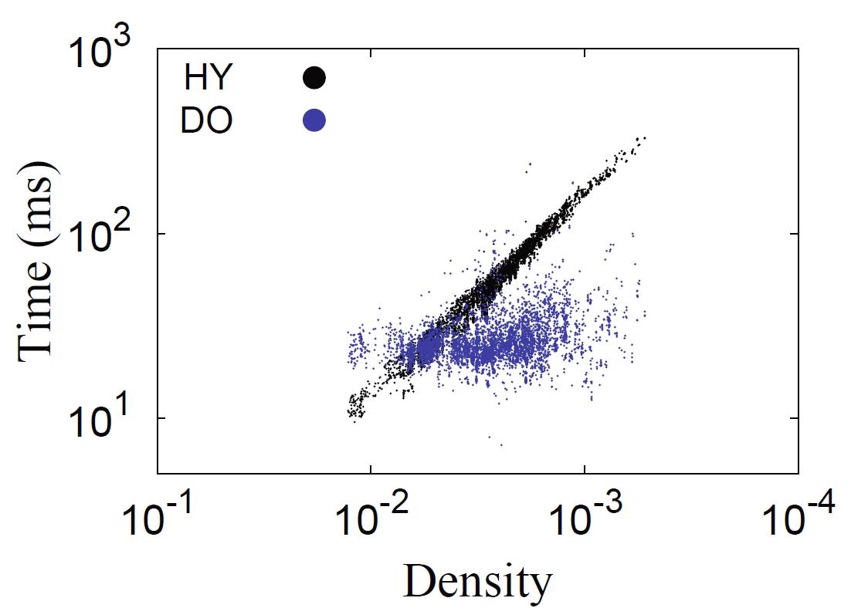
Evaluation of the Effect of Density
Density influences time cost in the one-to-many access pattern
Ratio of number of destinations to number of vertices of the road network visited for a given region
Time cost increases with density in the algorithms that are good for one-to-one (Integrated)
Time cost is not related to density in the algorithms that are good for one-to-many (Hybrid)
Region Query: fix search space
KNN Query: fix K

Slide 23
Outline
Background & Motivation
Spatial analytical queries
Access patterns & existing methods
Two architectures
Hybrid architecture
Integrated architecture (inside a database)
$ε$-distance oracle
SQL examples
Evaluation
Throughput
Region query, KNN query and Density
Conclusions

Slide 24
Conclusions
One-to-One:
Integrated is much better than Hybrid in time and throughput
One-to-Many
Depends on the density of targets
Integrated is faster than Hybrid in most real applications
Ease of use
Integrated is much better than Hybrid
Future work
Embed it into a distributed memory system, e.g., Spark
Aware of traffic changes for different periods of time

Slide 25
Thanks

Slide 26
Motivation
Throughput
How many distance computations per second
Existing Solutions
Focus on decreasing the latency time
Google Distance Matrix
Limit non-paying users to submit 100 shortest distances per query
Limit paying customers to submit 625 shortest distances per query
ArcGIS Network Analyst extension in Esri
Using Dijkstra’s algorithm
Require a high throughput solution!
Notes:
logistics, tour planning,
and spatial business intelligence

Slide 27
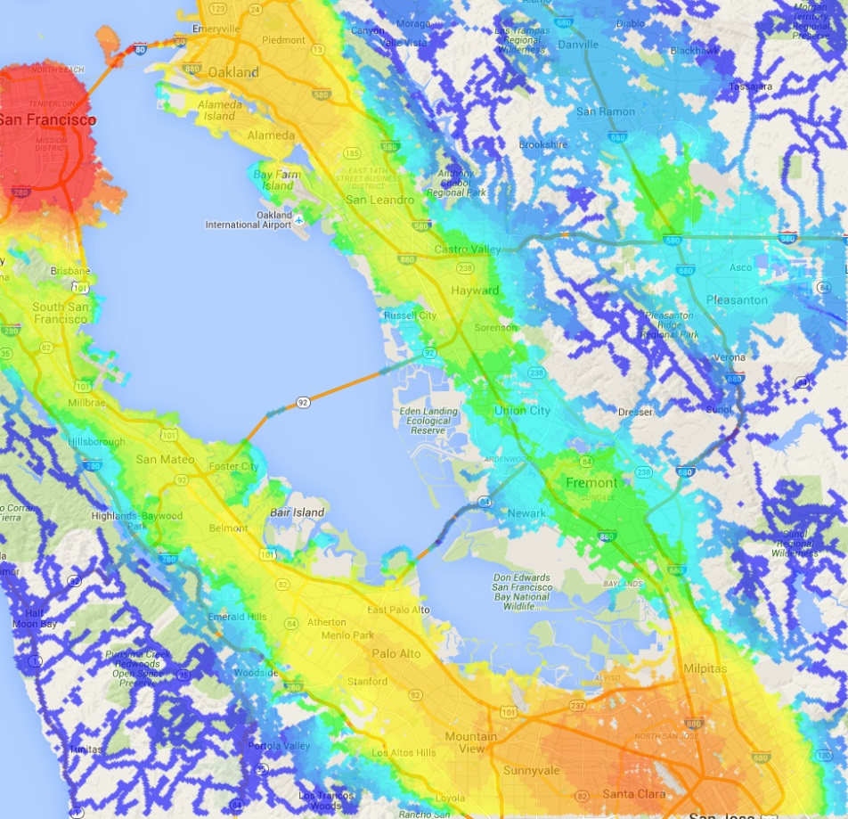
$ε$-Distance Oracle
Accessibility to jobs in the Bay Area
Jobs that are accessible within 10KM by car
$ε$-DO, $ε=0.25$
Dijkstra’s algorithm

Slide 28
Motivation
Applications: Logistics, Tour planning, Spatial business intelligence
Use cases from Esri web boards
Case 1.
Case 2.
Case 3.
Throughput!
I am a taxi operator running a fleet of taxis. I have a dataset of taxi trips such that each trip has a latitude and longitude values for both a pickup and a drop off point, as well as for way points at irregular intervals. I want to obtain the total number of miles travelled by each taxi this month.
I am an operator of a large hospital and have the geocoded address of my patients and the locations of my clinics. Our hospital has more than 500 clinics across the country. I want to get the average drive time for patients per clinic. This is an important metric in healthcare. This distance also informs us of the need to open new clinics or relocate existing ones to better serve our patients.
I have a trucking company with 10 trucks that deliver thousands of packages for a popular retailer. A common operation that I run several times during each day is determining which packages should be loaded on to which truck and the order in which they should be delivered. For this purpose, the input is a network distance matrix between the delivery locations of all current packages. An optimization program would decide how to assign packages to trucks and the order in which to deliver them.
Notes:
logistics, tour planning,
and spatial business intelligence

Slide 29
Access Patterns for Distance Queries
Access Patterns for shortest distances in such queries
One-to-One: a batch of source-target queries
One-to-Many: KNN
Many-to-Many: distance matrix
Speeding up specific spatial analytical queries (not general)
Reduce
Algorithm Type | One-to-One | One-to-Many
Scan-based | Contraction Hierarchies TNR etc | Dijkstra’s algorithm etc
Lookup-based | $ε$-Distance Oracle Hub labeling | -
Notes:
Contraction hierarchies

Slide 30
Evaluation
Throughput
How many distance computations per second?
Affected by access pattern, one-to-one or one-to-many
Query | Metric | Integrated | Hybrid - 7
10K random pairs | Time | 0.327 sec | 2026 sec
 | Throughput | 30581 dist/sec | 4.9 dist/sec
Distance Matrix (5,964$×$49,573) | Time | 8853.9 sec | 20139 sec
 | Throughput | 33392 dist/sec | 14680 dist/sec

